Slide 1


TRAINER TRACKING REPORT
Presented By:
Chetan Tekade
Ayush Raut
Tushar Vhanmane
Anushka Rupnar
Guided By:
Miss. Kiran Tiwari

Slide 2
Project Overview
Aim of Project
Implementation plan & timeline
Objectives
ER-Diagram
Entities
Back-End Architecture
Front-End Architecture
Demo Screenshots
Future Scope
Conclusion

Slide 3


Aim of Project
The aim of the project "Trainer Tracking Report" is to develop a comprehensive Web solution that facilitates efficient management of trainer-related activities within an organization offering Multiple courses.

Slide 4



Implementation & Timeline
Phase 1: Find Problem statement in Symbiosis
To find the latest and most accurate information on problem statements at Symbiosis.
1
2
Phase 2: Research and Analysis
research and analysis to gain a deeper understanding of the identified problem.
3
Phase 3: Development and Design
Phase 3 utilizes Spring Boot for backend logic, Angular for frontend design, and HTML/CSS for visual elements. MySQL is employed for effective data management in the project.

Slide 5
Objectives
Efficient Trainer Management:
Create a system to manage information about trainers, including their personal details, courses taught, and availability.
Tracking Total Hours Taught:
Implement functionality to accurately track and record the total number of hours taught by each trainer across various courses and topics.
User-Friendly Interface:
Design an intuitive and user-friendly interface for trainers, administrators, and other stakeholders to easily access and interact with the system.

Slide 6





Technology Stack
Requirement
Description
HTML
HTML(HyperText Markup Language) is used in web pages because it provides a structure for the content on the page.
CSS
CSS (Cascading Style Sheets) is used to style and layout web pages.
Angular is a platform and framework for building single-page client applications
Angular
Spring Boot is a tool that makes developing web application and microservices with Spring Framework faster and easier
Spring Boot
MySQL is a relational database management system.
It is used to access databases.
MySQL

Slide 7

ER-Diagram
Many Batch have Many Trainer
Many Trainer have Many Courses
Batch
Trainer
Course
PK
batch_id Batch_name
Int Varchar(30)
PK
trainer_id trainer_name trainer_email
Int Varchar(30) Varchar(30)
PK
course_id course_name
Int Varchar(30)
EX: 1) FullStack Java
2) Machine Learning
3) Aptitude & Reasoning
4) Soft Skill (Eng)
One Course have Many Topic
Subtopic
Topic
PK
subtopic_id subtopic_name Subtopic_hours
Int Varchar(30) Varchar(30)
PK
topic_id topic_name Topic_hours
Int Varchar(30) Int
One Topic have Many Subtopic

Slide 8
Entities
Batch
Subtopics
Trainer
Topic
Course

Slide 9
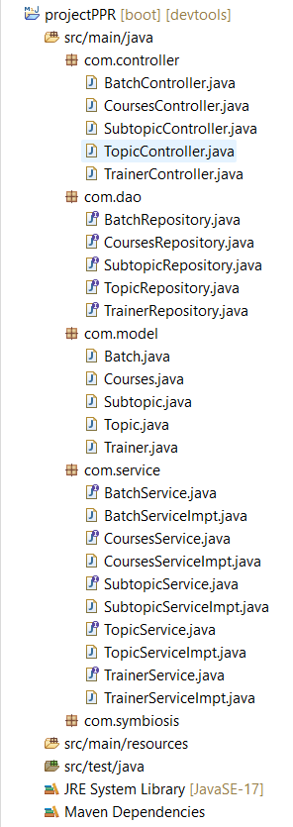
Back-end Architecture
1. Encapsulation:
Wrapping up of data members and member functions in single unit.
2. Abstraction:
Hiding internal implementation and show functionality.

Slide 10
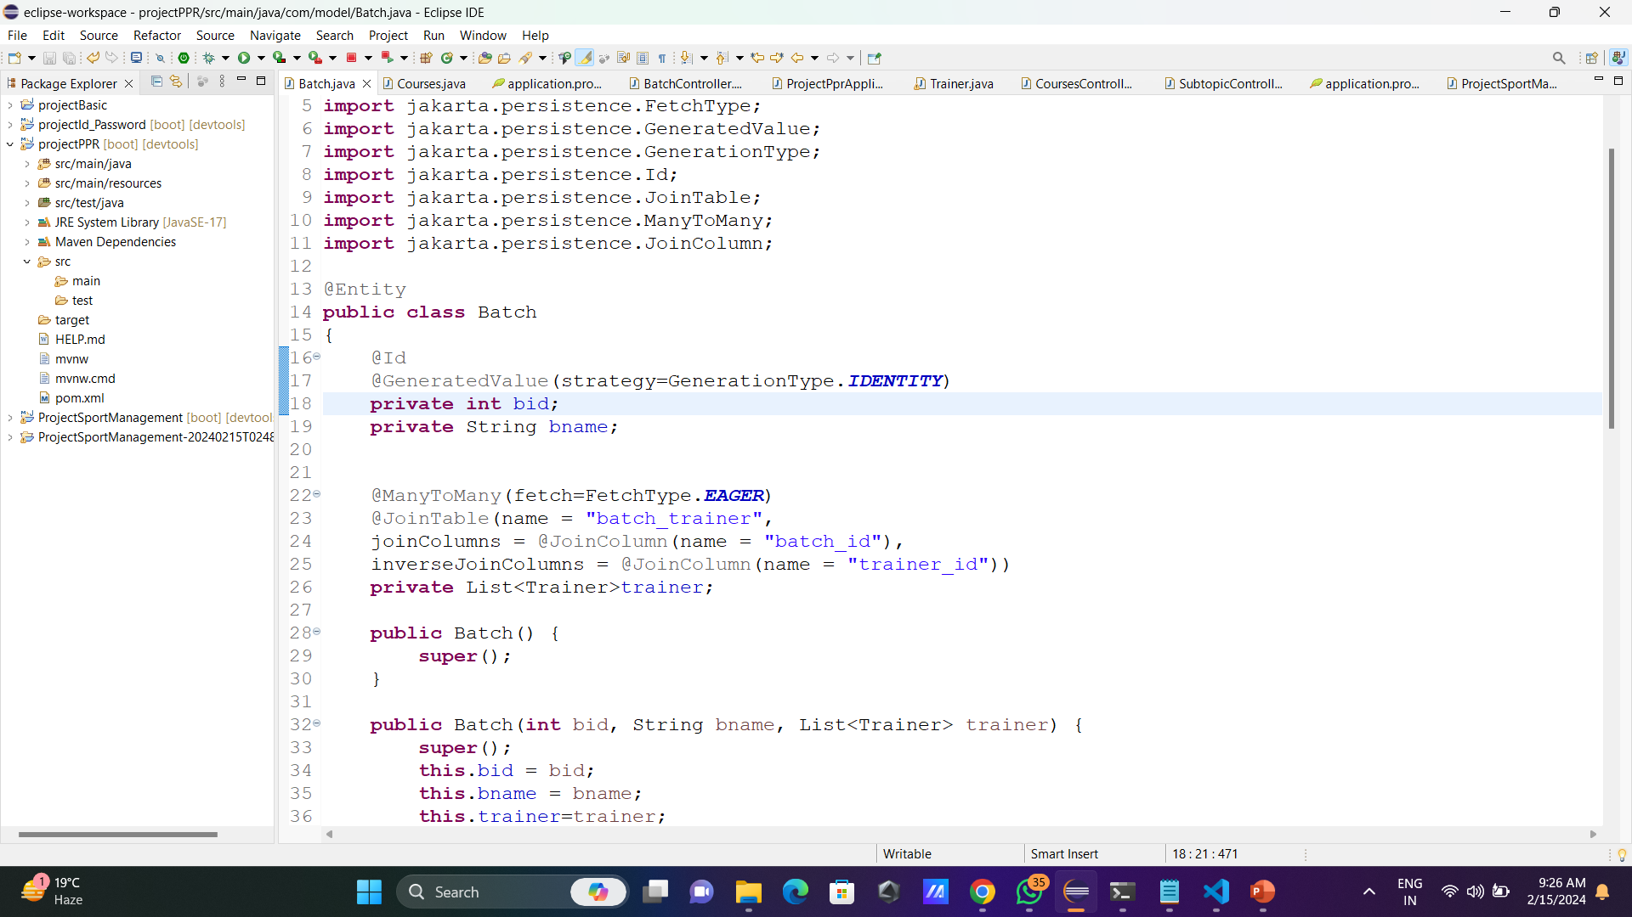
Back-end Architecture
A Many-To-Many relationship exists when two entities are linked in such a way that one entity has many (collections) of the other entity and vice versa.
The @JoinTable annotation is used to define the join table that connects the two entities
The @JoinColumn annotation is applied to the field or property representing the foreign key column in the entity class that owns the relationship.
3. JPA Mapping
A) Many-To-Many
Trainer
M
Allot
M
Course

Slide 11
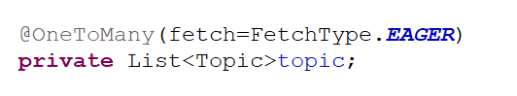
Back-end Architecture
B) One-To-Many
One-To-Many mapping means that one row in a table is mapped to multiple rows in another table.
A project remains incomplete without proper mapping, as it lacks the essential connections between entities.

Slide 12
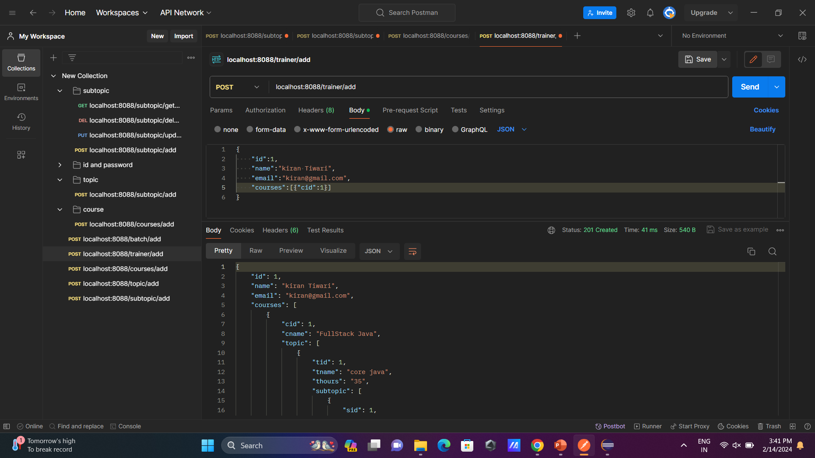
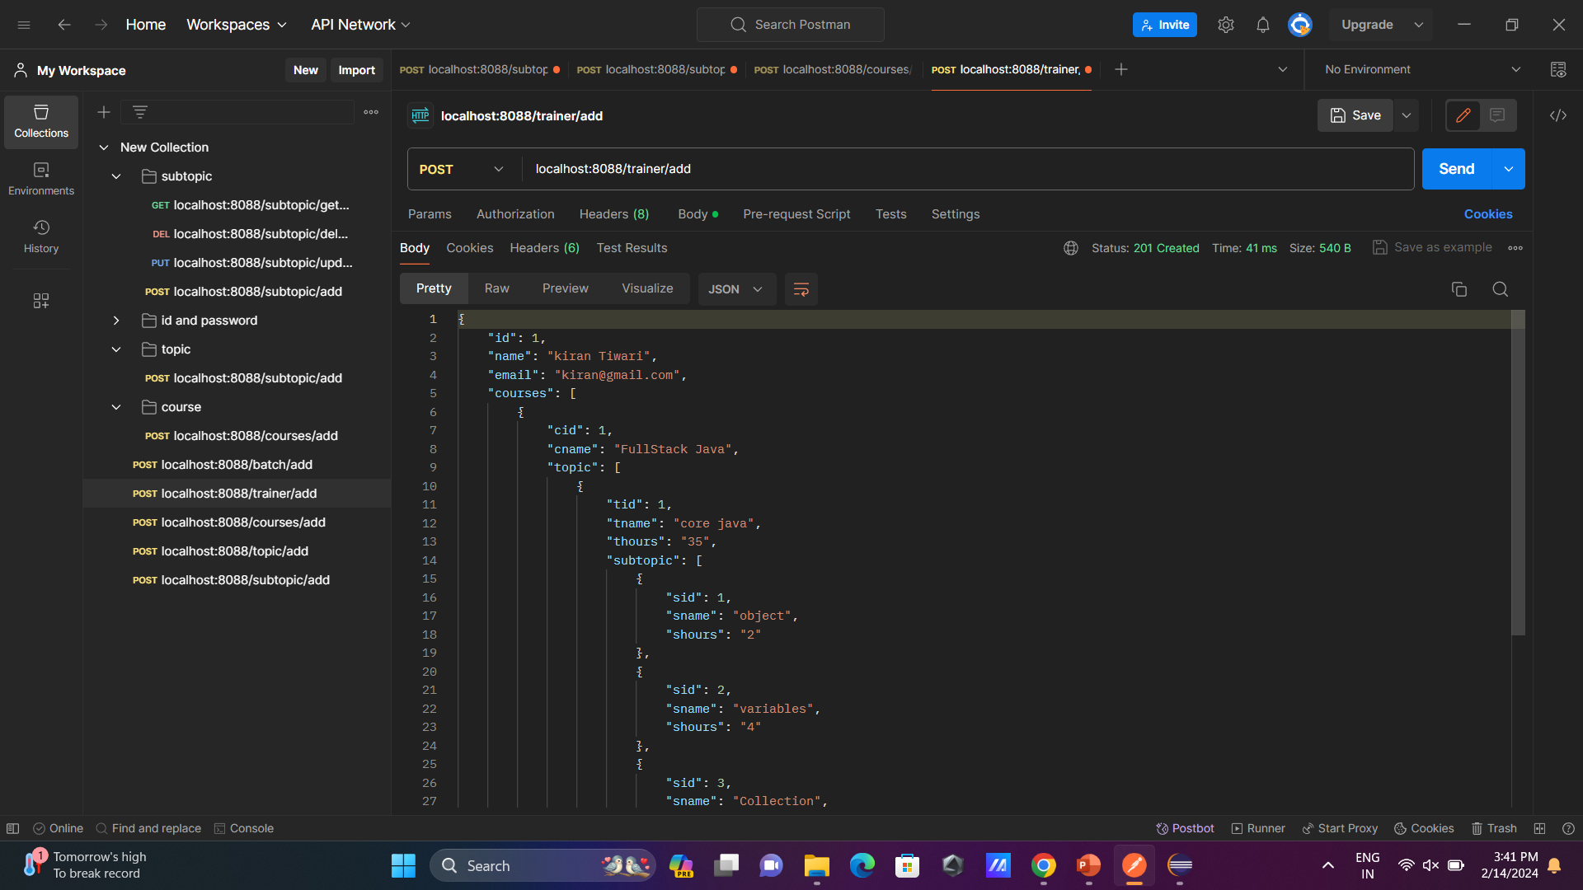
Back-end Architecture
4. Postman
Postman is an API platform for building and using APIs.
Postman allows the testing of web APIs.
METHODS
POST
GET
UPDATE
DELETE

Slide 13
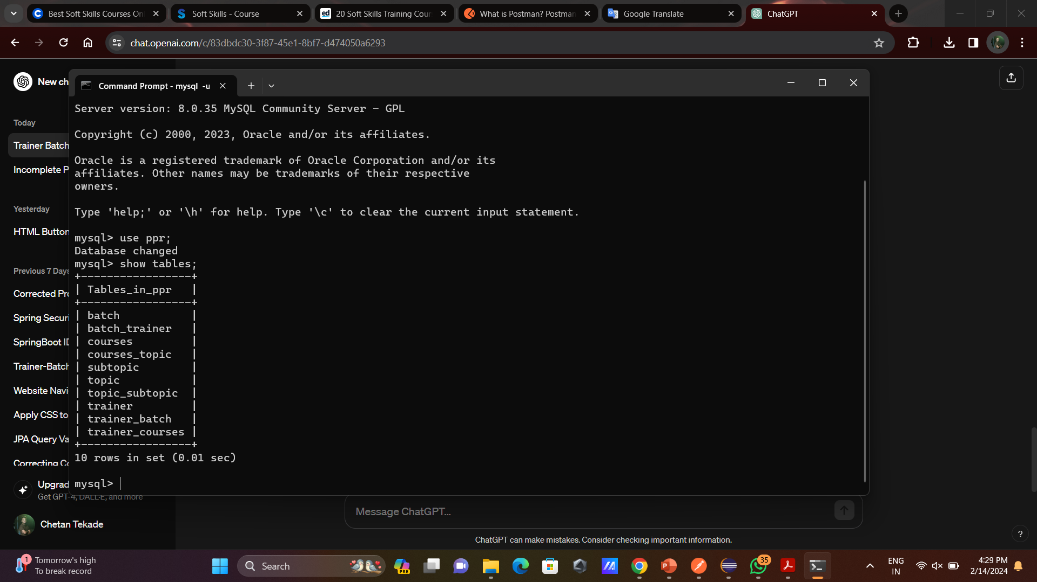
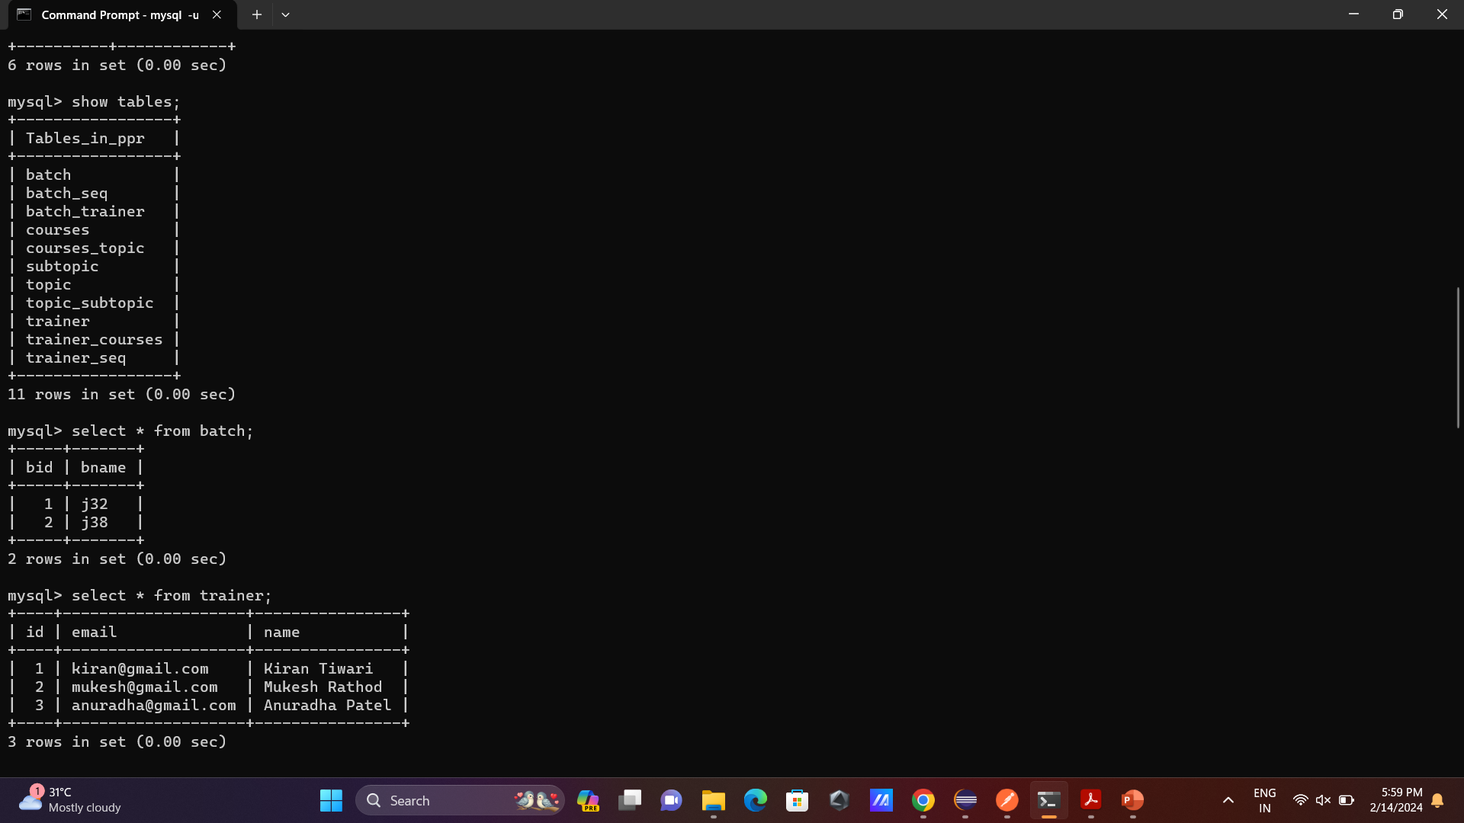
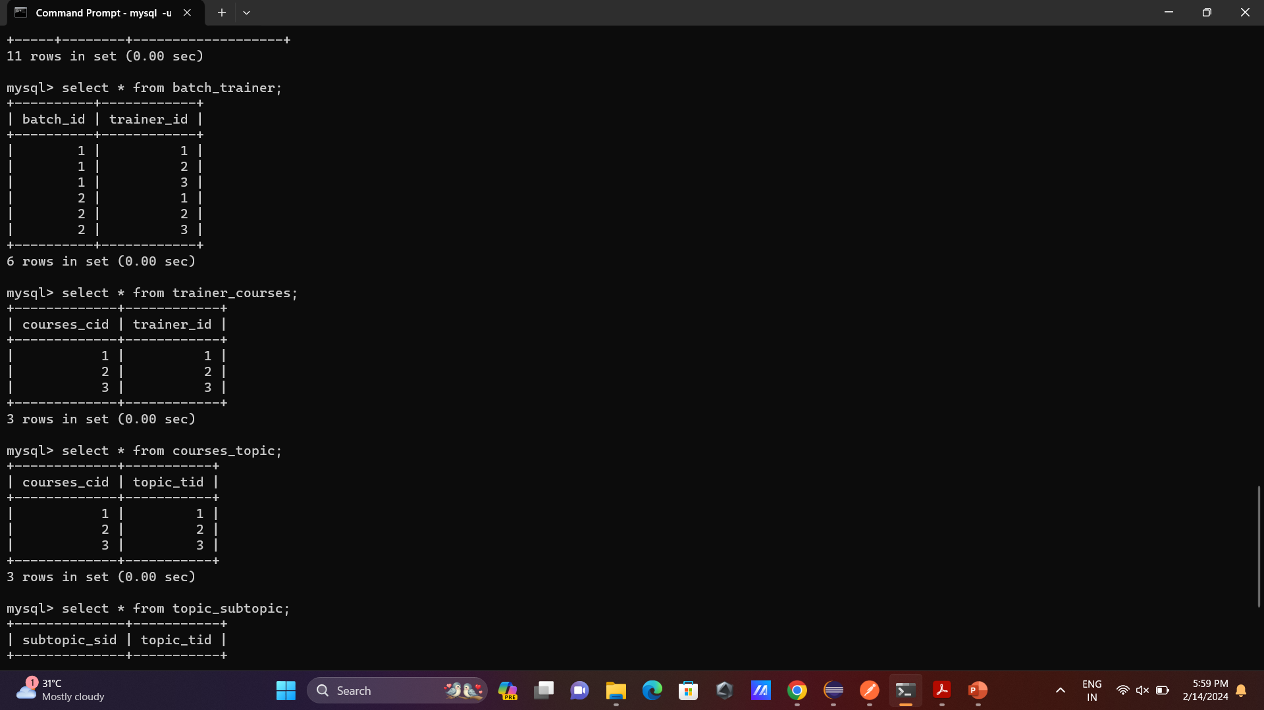
Back-end Architecture
4. MySQL(Database)
MySQL is a relational database management system based on SQL used to store, retrieve, and manipulate data in relational databases.
All Tables:
Trainer:
Batch:
Mapped table of batch_trainer:

Slide 14
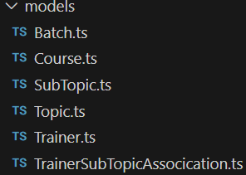
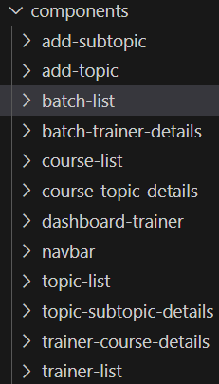
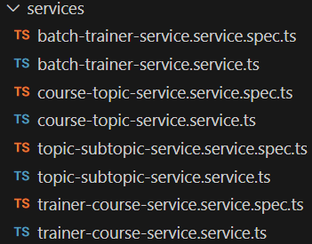
Front-end Architecture
Angular Js
1. Models
2. Components
3. Service

Slide 15
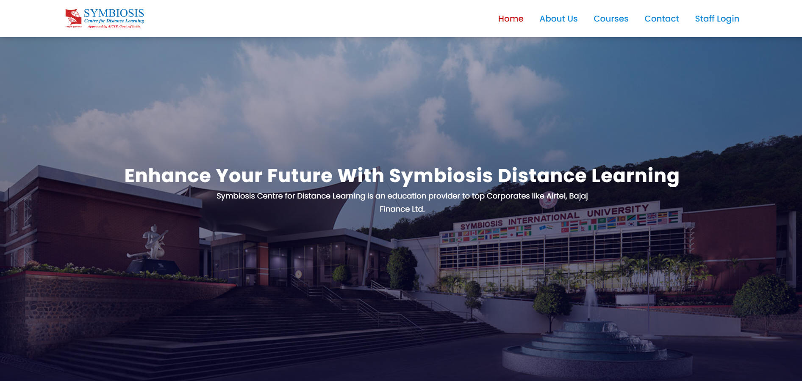
Demo Screenshots

Slide 16


Slide 17
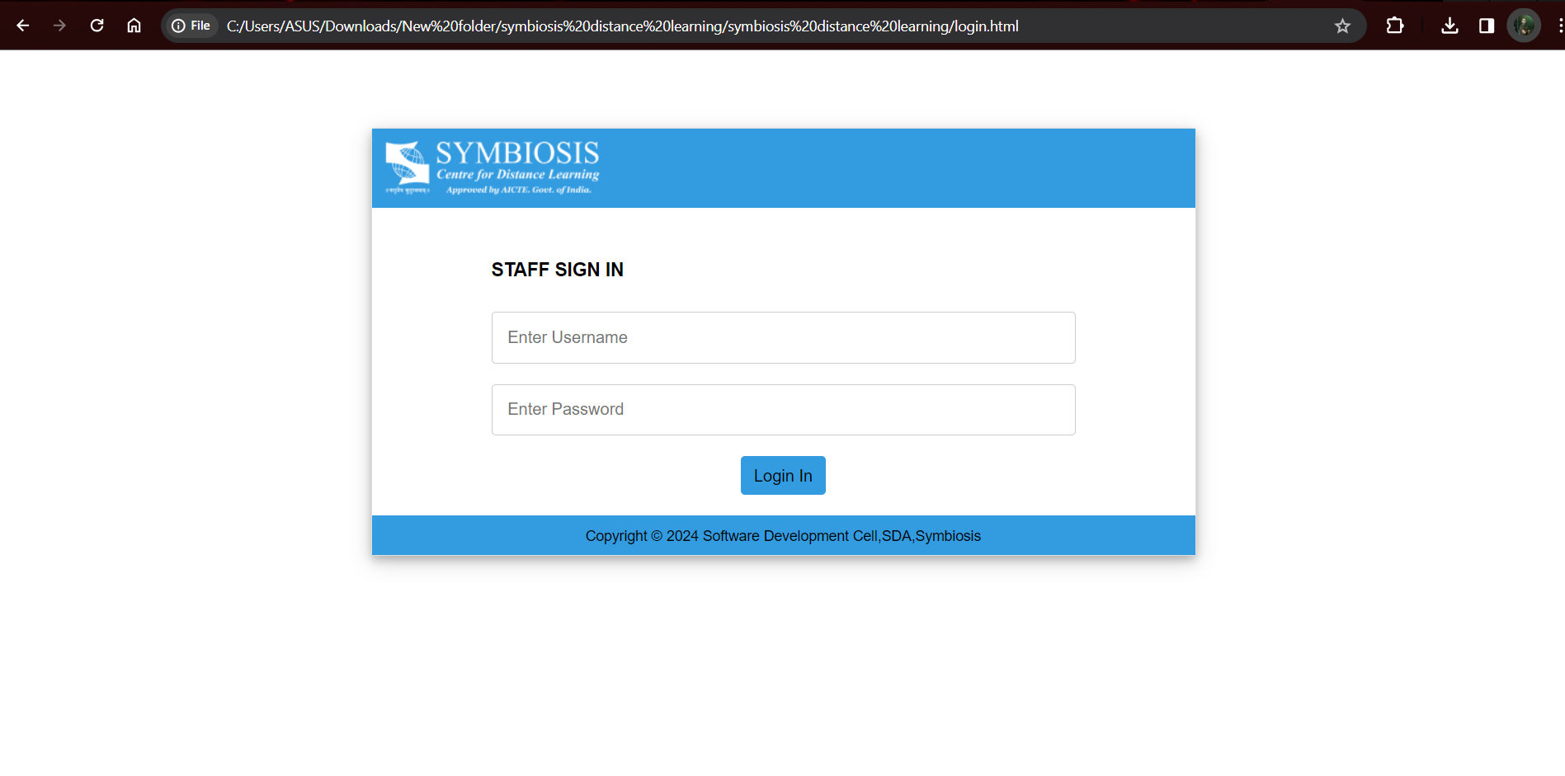

Slide 18
Future Upgradation
Attendance and Presence Management:
Develop features to monitor trainer attendance and presence during scheduled sessions, ensuring accountability and reliability.
Performance Analysis and Reporting:
Generate detailed reports and analytics to evaluate trainer performance, including metrics such as session attendance, student feedback, and course completion rates.
Resource Optimization:
Optimize resource allocation by analyzing trainer availability and workload to ensure efficient utilization of trainer resources.

Slide 19
Conclusion
Create a system to manage information about trainers, including their personal details, courses taught, and availability.
Implement functionality to accurately track and record the total number of hours taught by each trainer across various courses and topics.

Slide 20
Thank You

